Slide 1


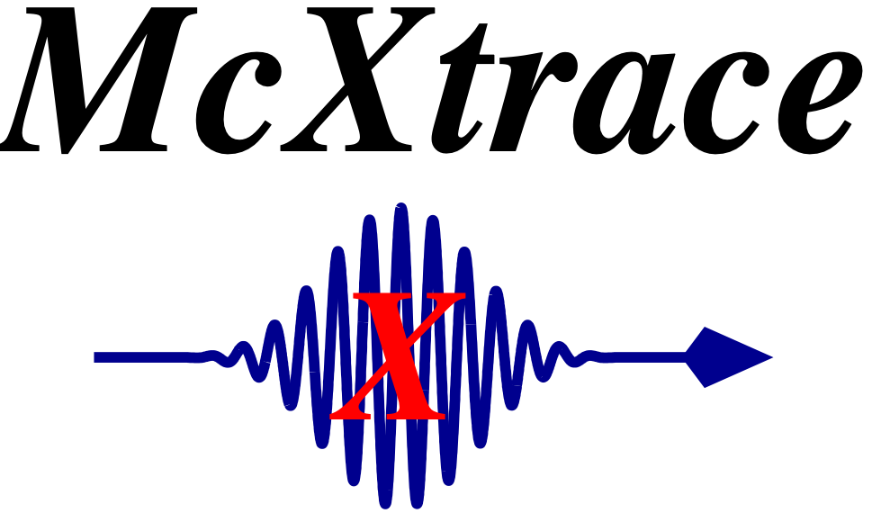
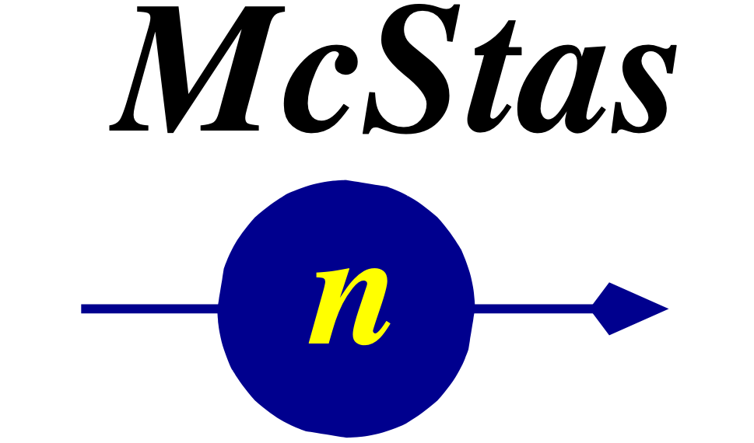
McStas and McXtrace: simulation tools for neutron- and X-ray instruments
Peter Willendrup^{1,2},
¹NEXMAP, Physics Department, Technical University of Denmark, Denmark
²ESS Data Management & Sofware Center, Denmark
McStas and McXtrace: simulation tools for neutron- and X-ray instruments

Slide 2
Agenda
Introduction to McStas & McXtrace
Neutrons and X-rays
Monte Carlo method
Ray-tracing
Components of scattering instruments
A short description of this afternoons exercise
McStas and McXtrace: simulation tools for neutron- and X-ray instruments

Slide 3
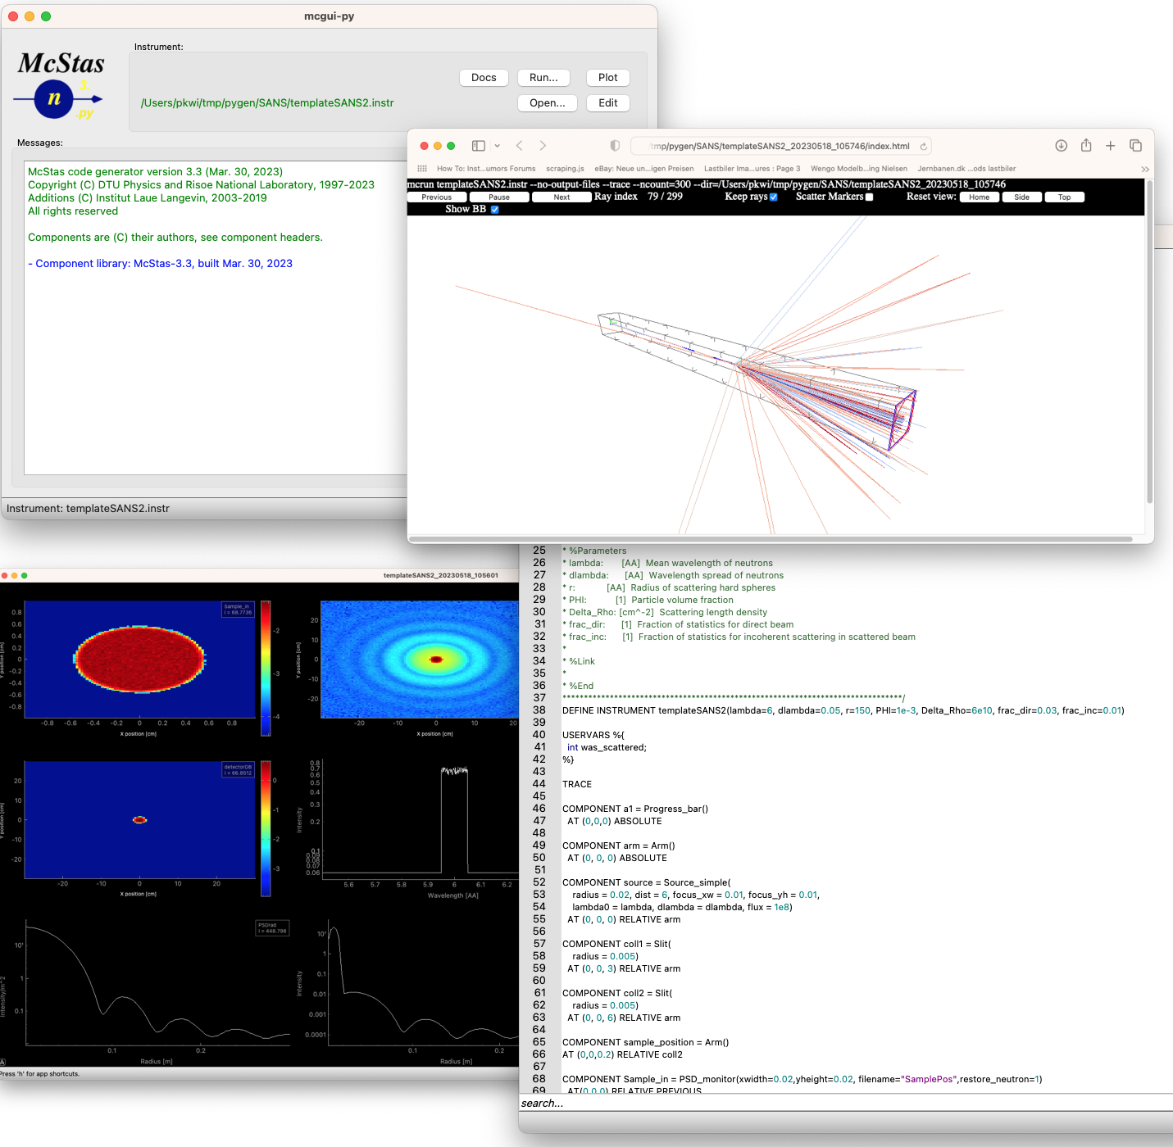
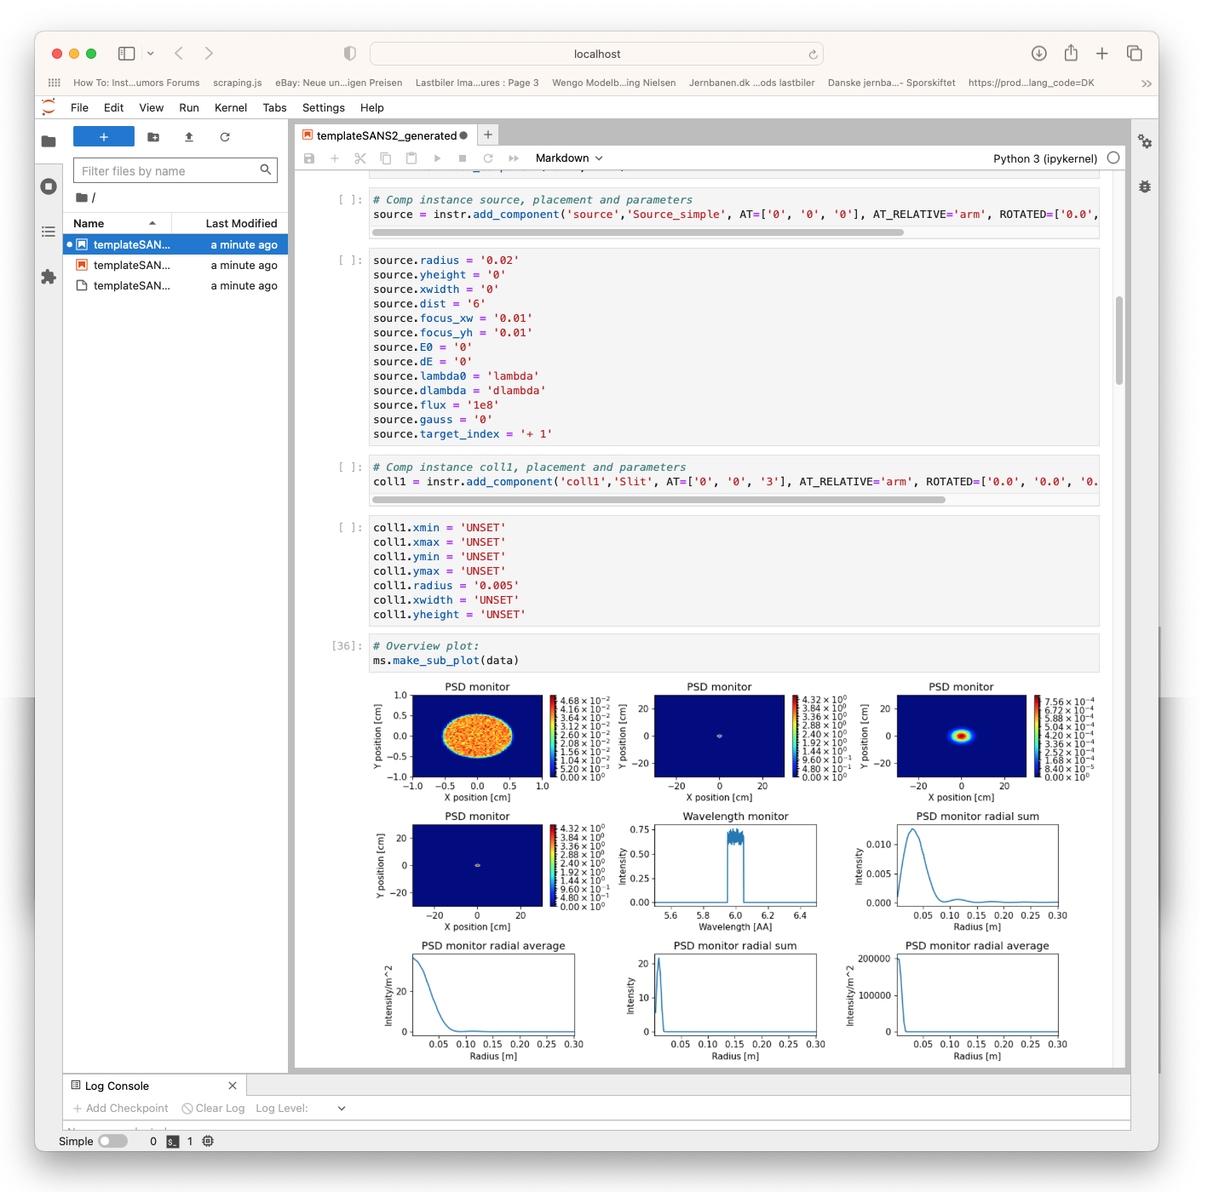
McStas & McXtrace
Neutron- and X-ray simulation tools for instruments and experiments
McStas and McXtrace: simulation tools for neutron- and X-ray instruments

Slide 4
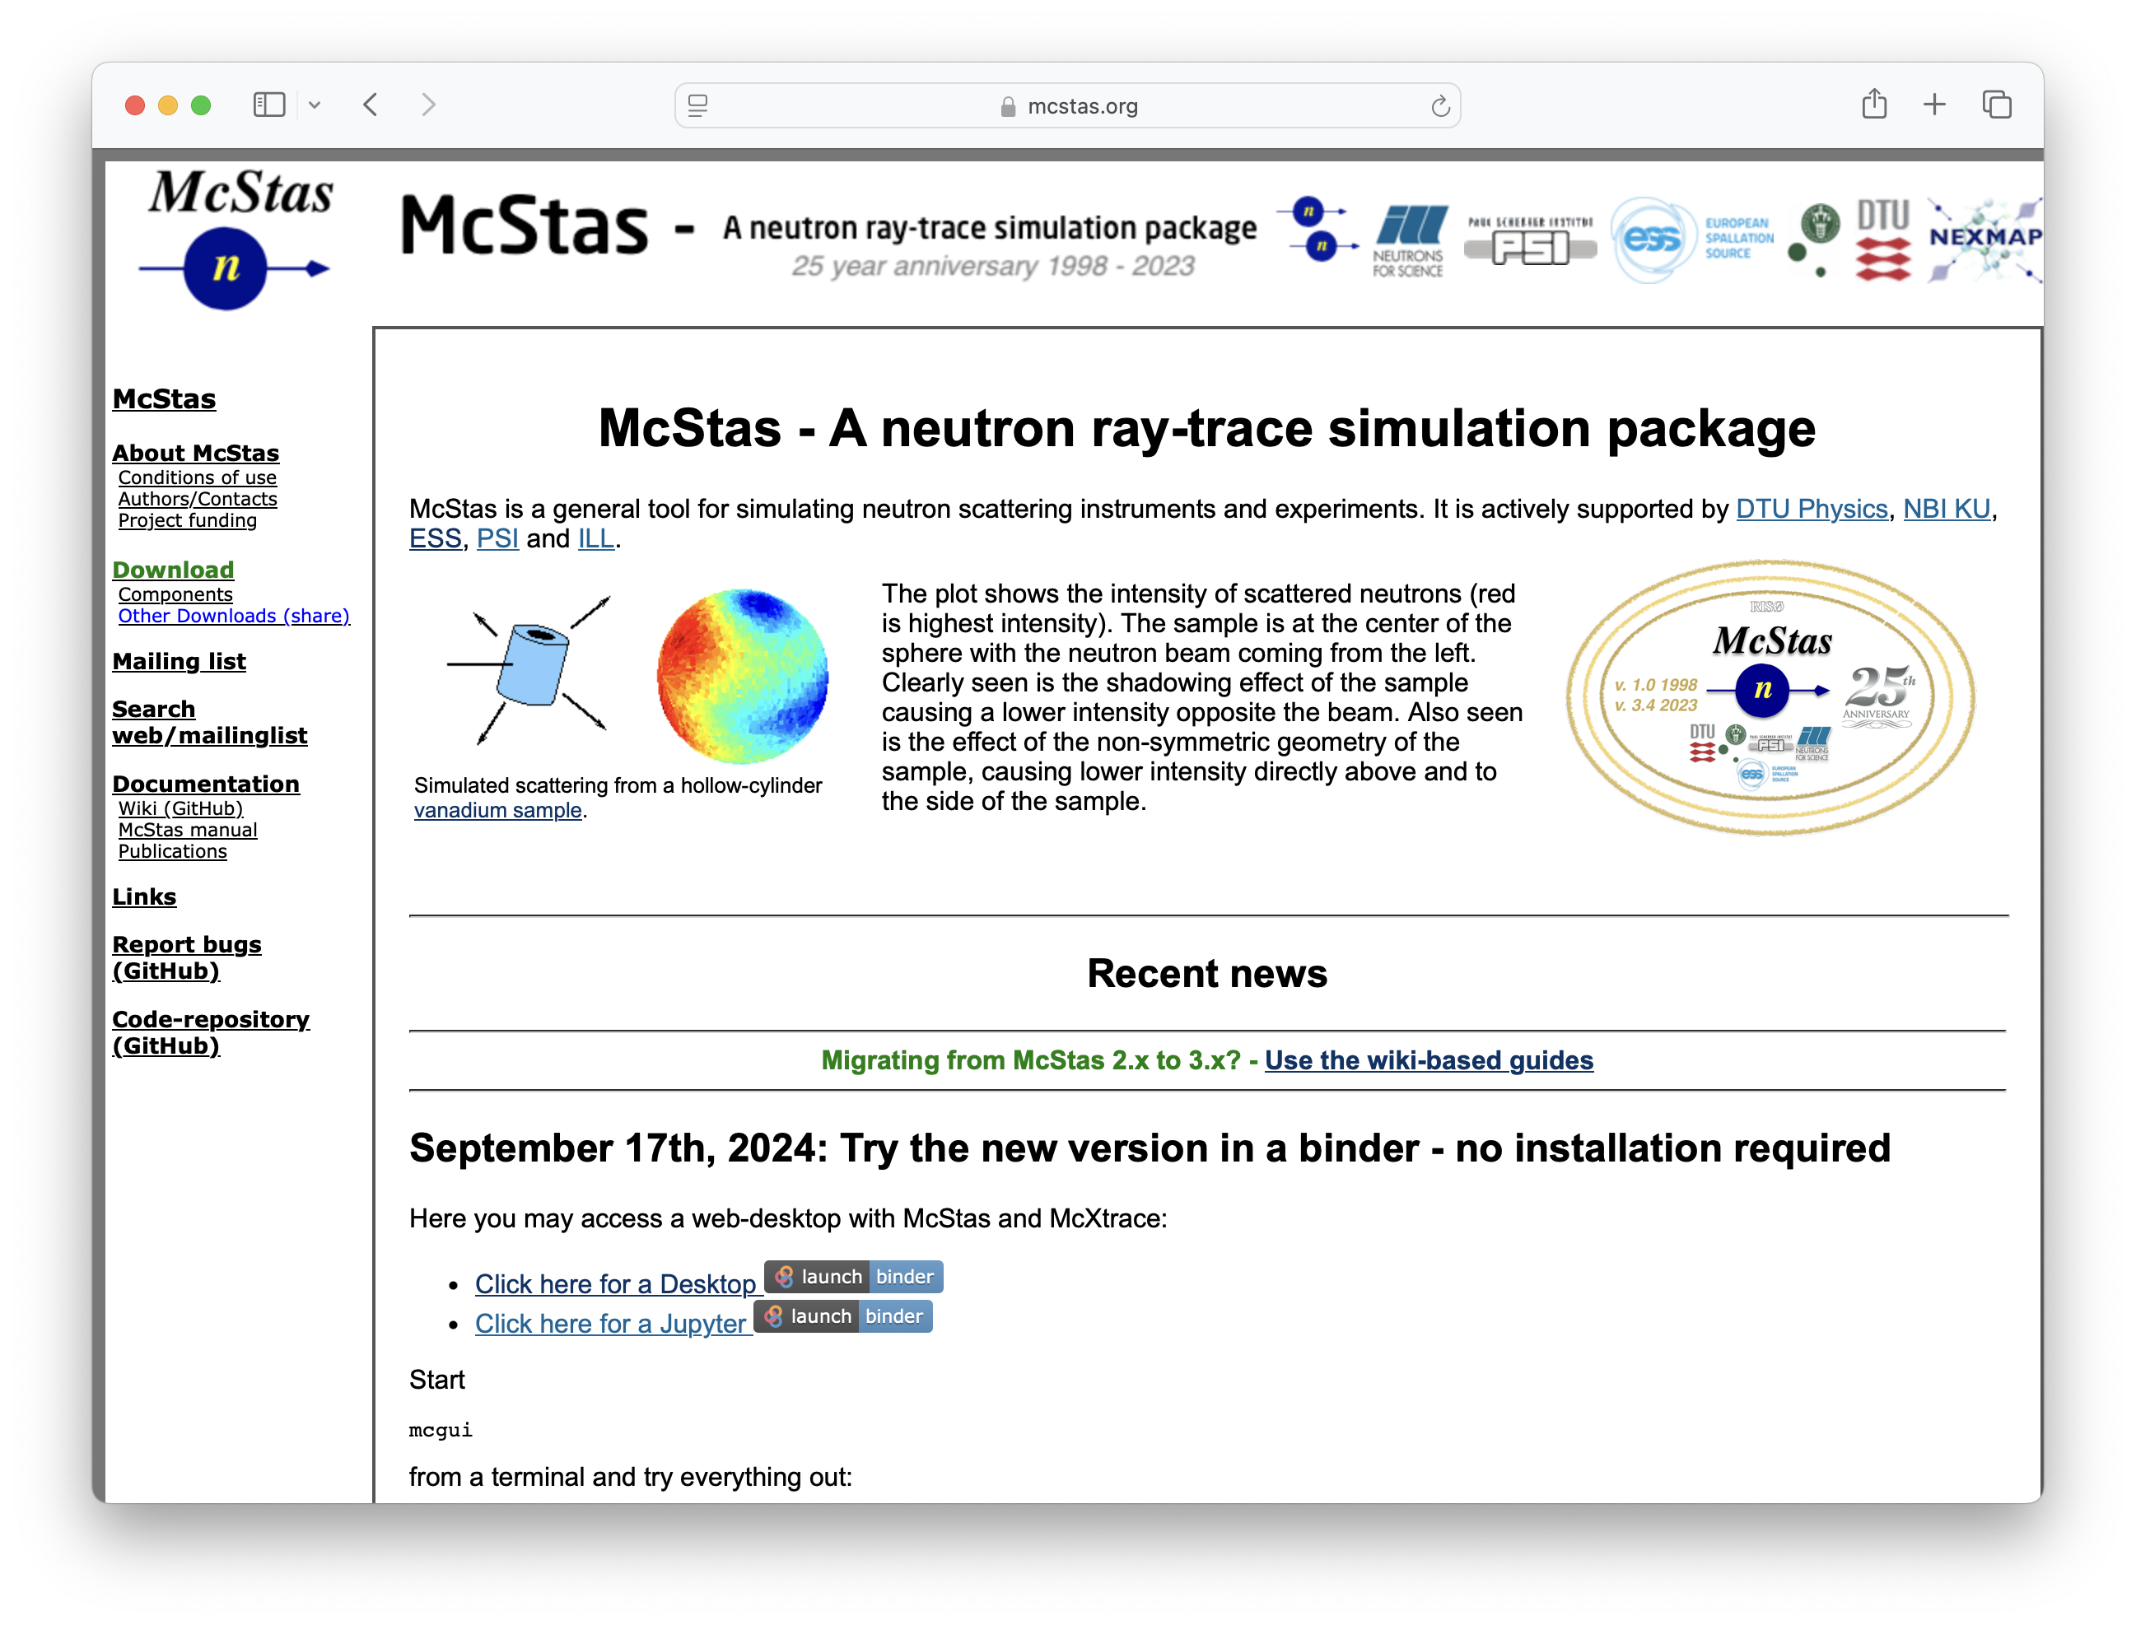

McStas Introduction
Flexible, general simulation utility for neutron scattering experiments.
Original design for Monte carlo Simulation of triple axis spectrometers
Developed at DTU Physics, ILL, PSI, Uni CPH, ESS
V. 1.0 by K Nielsen & K Lefmann (1998) RISØ
Currently ~ 4 people full time plus students
GNU GPL license
Open Source
Project website at
http://www.mcstas.org
mcstas-users@mcstas.org mailinglist
McStas and McXtrace: simulation tools for neutron- and X-ray instruments

Slide 5
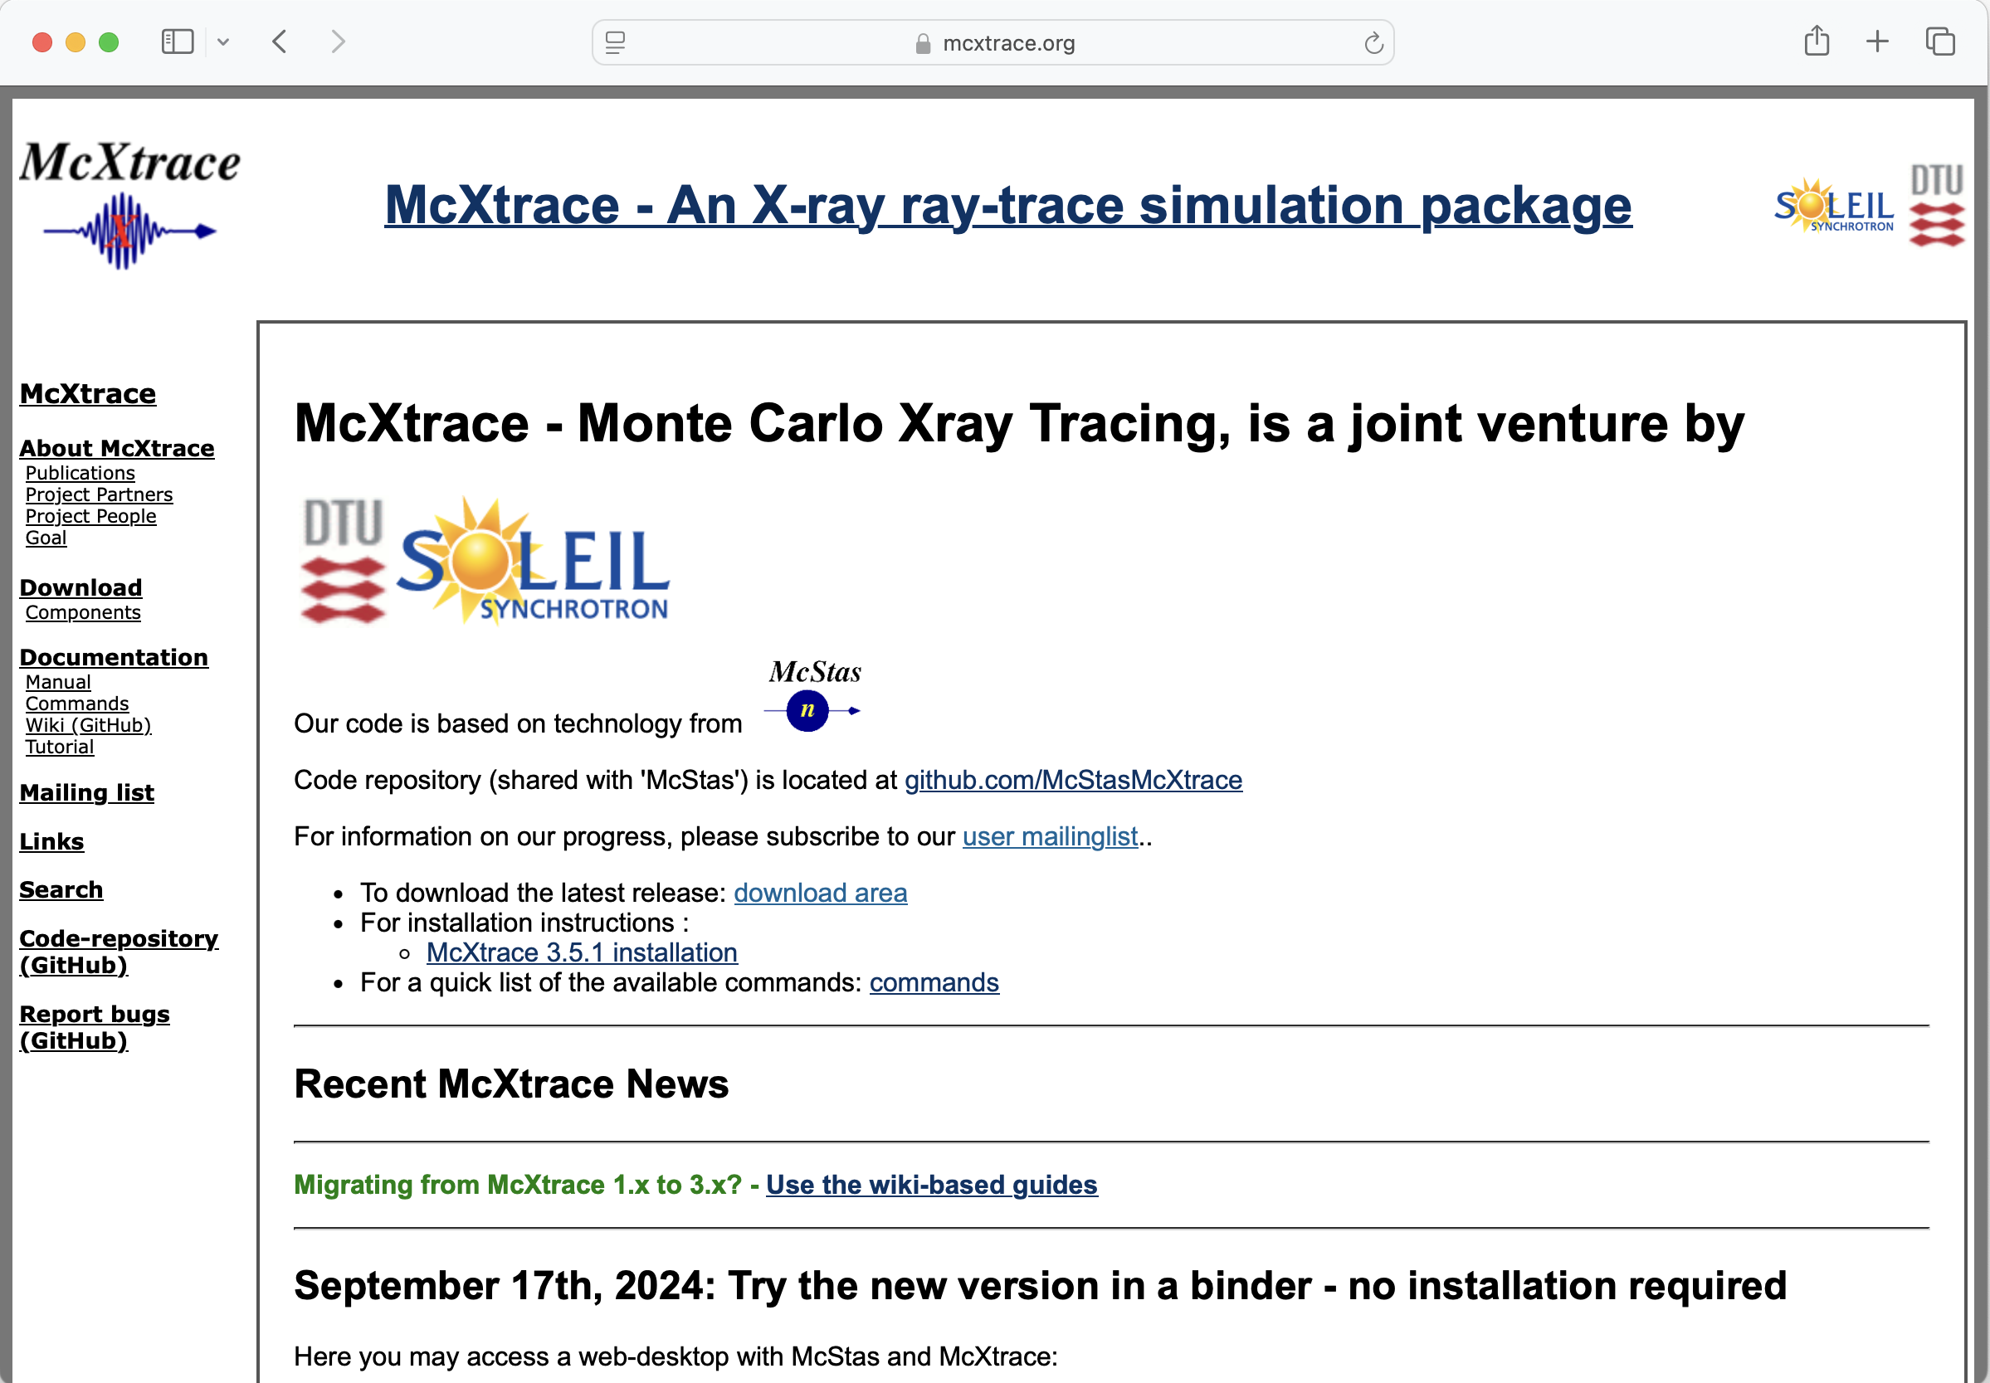
McXtrace - same idea, but for X-rays (2009-)
McStas and McXtrace: simulation tools for neutron- and X-ray instruments

Slide 6
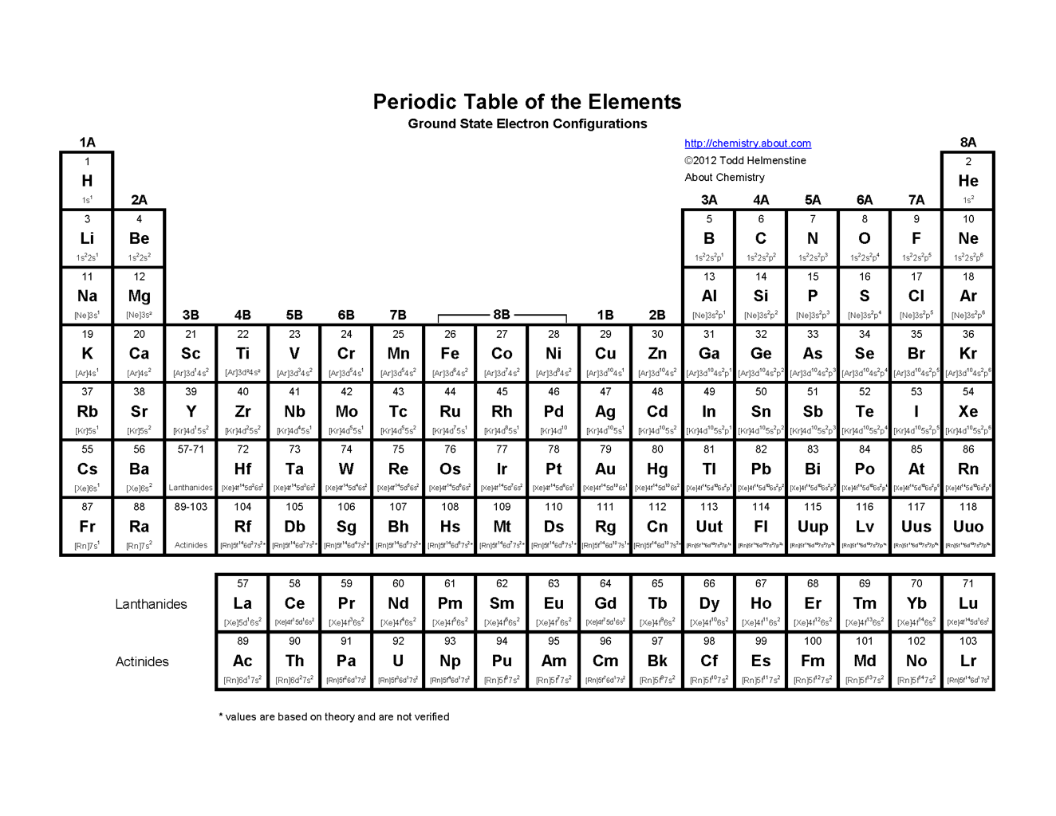
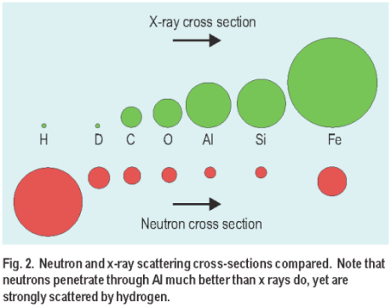



Both neutrons and X-rays interact with atoms
X-rays “see” the electron cloud surrounding the atomic nucleus – the higher atomic no. ‘Z’, the more scattering
In contrast neutrons “see” the nucleus – no simple connection between level of scattering and atomic no.
Result: Two very different response/contrasts
Neutron magnetic moment,
sensitivity to magnetical structures,
polarization techniques (Larmor)
Large contrast H vs D,
ideal for biological systems,
via deuteration

Slide 7
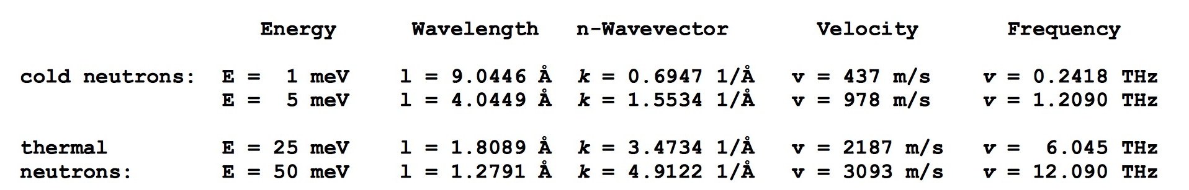
Both neutrons and X-rays interact with atoms
X-rays “see” the electron cloud surrounding the atomic nucleus – the higher atomic no. ‘Z’, the more scattering
In contrast neutrons “see” the nucleus – no simple connection between level of scattering and atomic no.
Result: Two very different response/contrasts
Low velocities makes beam-tailoring
using mechanical devices feasible

Slide 8
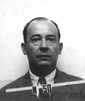
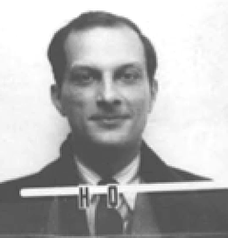
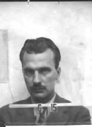
Monte Carlo techniques
During WW2, “numerical experiments” were applied at Los Alamos for solving mathematical complications of computing fission, criticality, neutronics, hydrodynamics, thermonuclear detonation etc.
Notable fathers: John v. Neumann Stanislav Ulam Nicholas Metropolis
Named “Monte Carlo” after Ulam’s fathers frequent visits to the Monte Carlo casino in Las Vegas
Initially “implemented” by letting large numbers of women use tabularized random numbers and hand calculators for individual particle calculations
Later, analogue and digital computing devices were used
McStas and McXtrace: simulation tools for neutron- and X-ray instruments

Slide 9
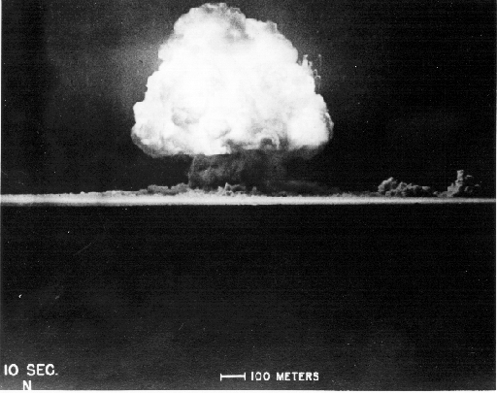
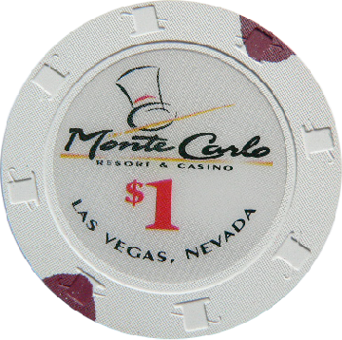
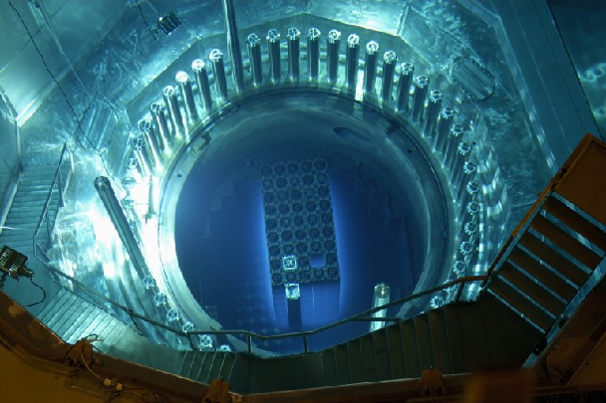
Monte Carlo techniques
Los Alamos has since then developed and perfected many different monte carlo codes leading to what is today known as the codes MCNP5 and MCNPX
State of the art is MCNP6 that features numerous (even exotic) particles
MCNP was originally Monte Carlo Neutron Photon, later N-Particle
Mainly used for high-energy particle descriptions in weapons, power reactors and routinely used for estimating dose rates and needed shielding
Not much focus on crystalline / ordered material and coherent scattering of neutrons due to the focus on high energies
McStas and McXtrace: simulation tools for neutron- and X-ray instruments

Slide 10
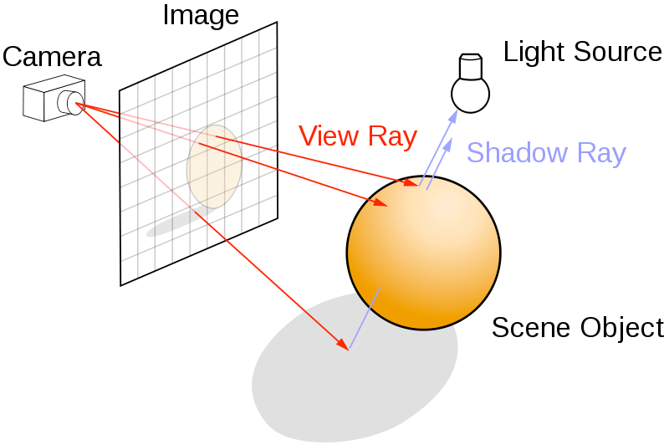
Ray-tracing methods
When neutrons move in “free space”, we use ray-tracing - but in most cases in direction source -> detector
Of course parabolas rather than straight lines are uses to implement gravity
McStas and McXtrace: simulation tools for neutron- and X-ray instruments

Slide 11
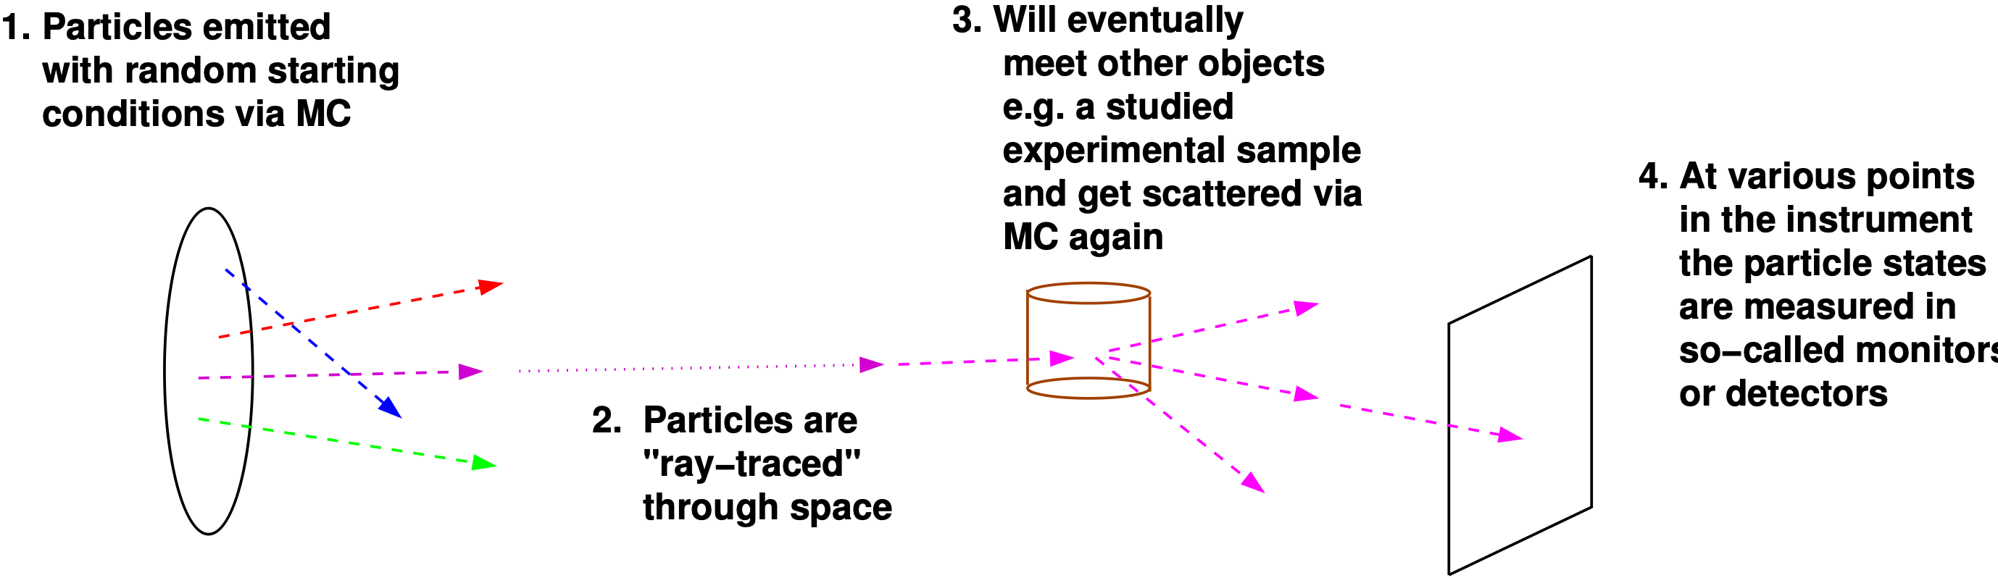
Overall picture: Monte Carlo Ray-Tracing
Important efficiency mechanisms:
“Focusing” - e.g. source to beamport only (4π vs. limited solid angle only)
Rather vs. single particle description, absorption handled though statistics and downscaling the ray weight
McStas and McXtrace: simulation tools for neutron- and X-ray instruments

Slide 12
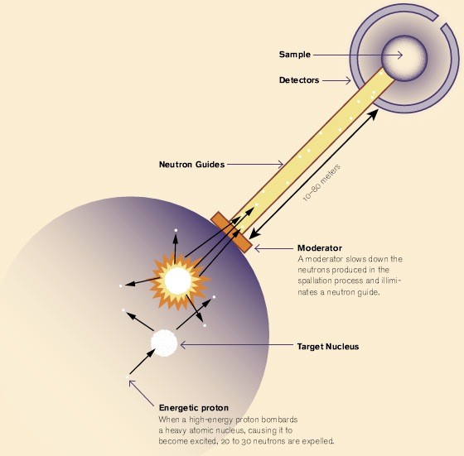
Components of neutron instruments
McStas and McXtrace: simulation tools for neutron- and X-ray instruments

Slide 13
Components of neutron instruments
In McStas the moderator is the “source”
McStas and McXtrace: simulation tools for neutron- and X-ray instruments

Slide 14
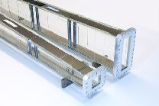
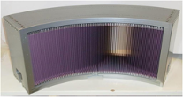
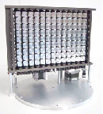
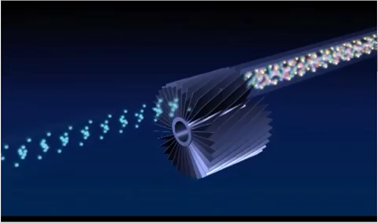
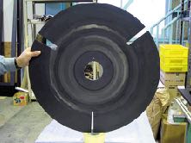
Components of neutron instruments
Neutron optics include things like:
Mirrors and guides
Collimators and slits
Diskchoppers, Fermi choppers and velocity selectors
Monochromators/Analysers
In McStas the moderator is the “source”
McStas and McXtrace: simulation tools for neutron- and X-ray instruments

Slide 15
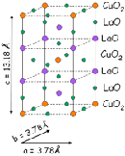
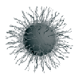
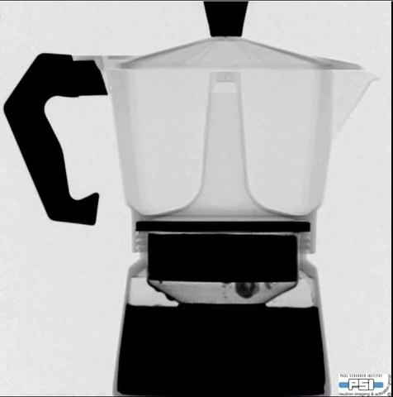
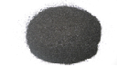
Components of neutron instruments
The sample:
Crystalline, powders, liquids, micelles, structures to image, inelastic features like phonons…
Neutron optics include things like:
Mirrors and guides
Collimators and slits
Diskchoppers, Fermi choppers and velocity selectors
Monochromators/Analysers
In McStas the moderator is the “source”
McStas and McXtrace: simulation tools for neutron- and X-ray instruments

Slide 16
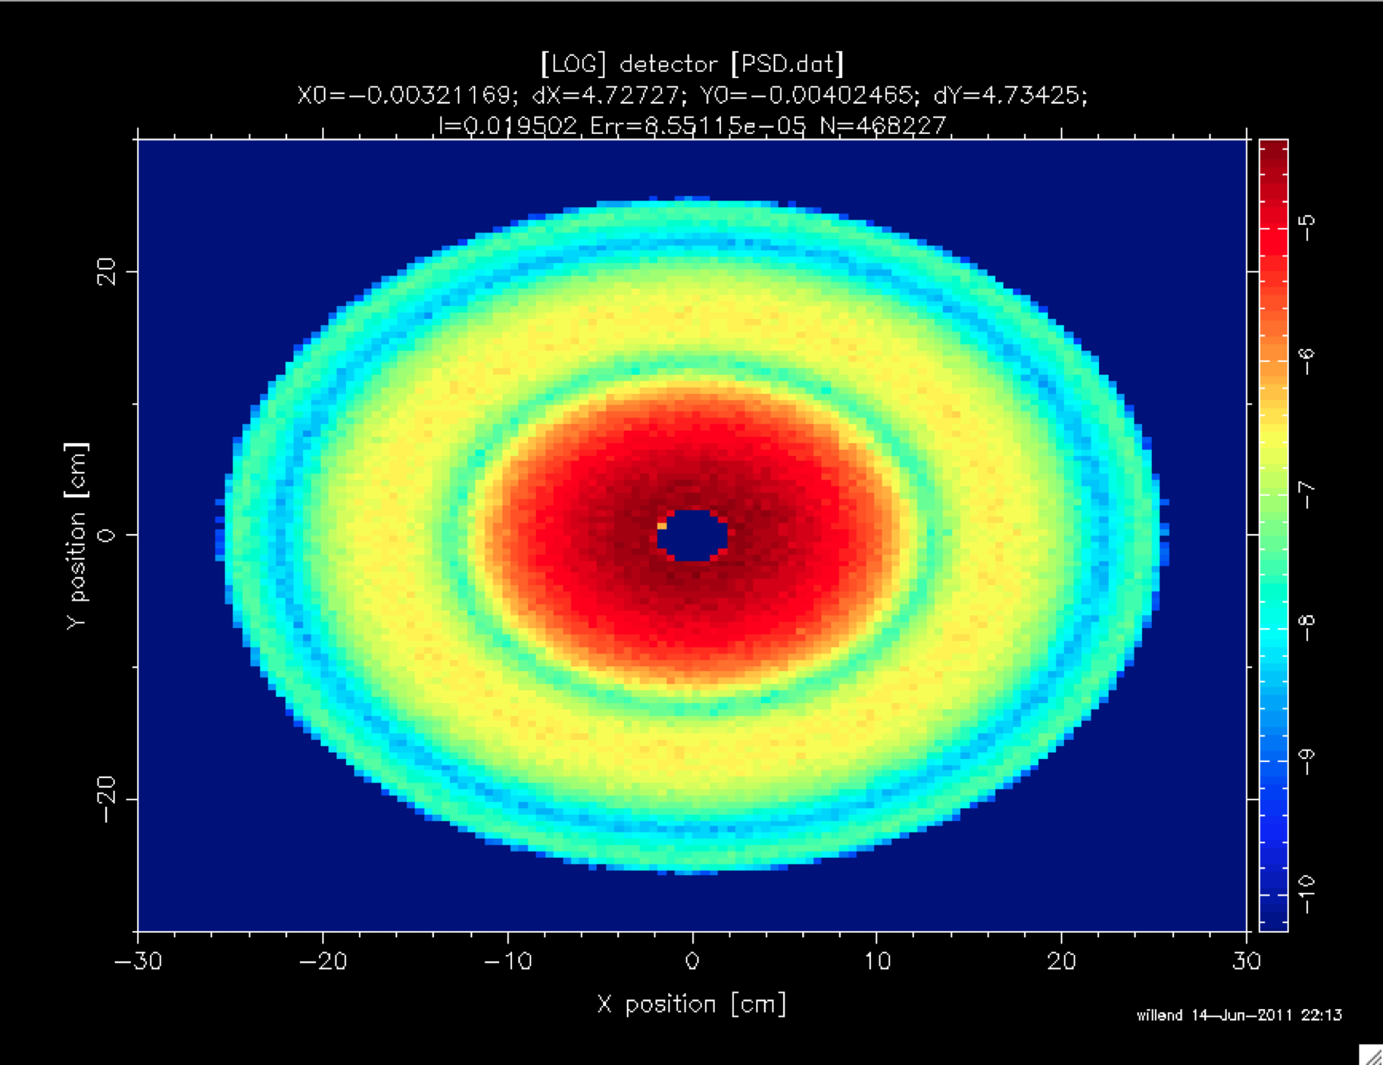
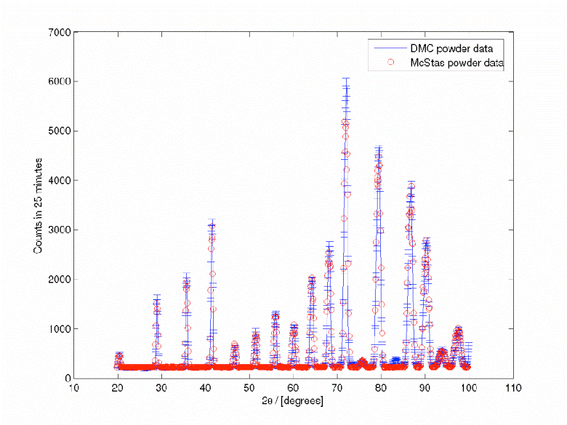
Components of neutron instruments
Detectors are “monitors” in McStas. Mostly they act as “perfect probes” and can be positioned thought your instrument gathering 1D/2D/ event lists…
The sample:
Crystalline, powders, liquids, micelles, structures to image, inelastic features like phonons…
Neutron optics include things like:
Mirrors and guides
Collimators and slits
Diskchoppers, Fermi choppers and velocity selectors
Monochromators/Analysers
In McStas the moderator is the “source”
McStas and McXtrace: simulation tools for neutron- and X-ray instruments

Slide 17

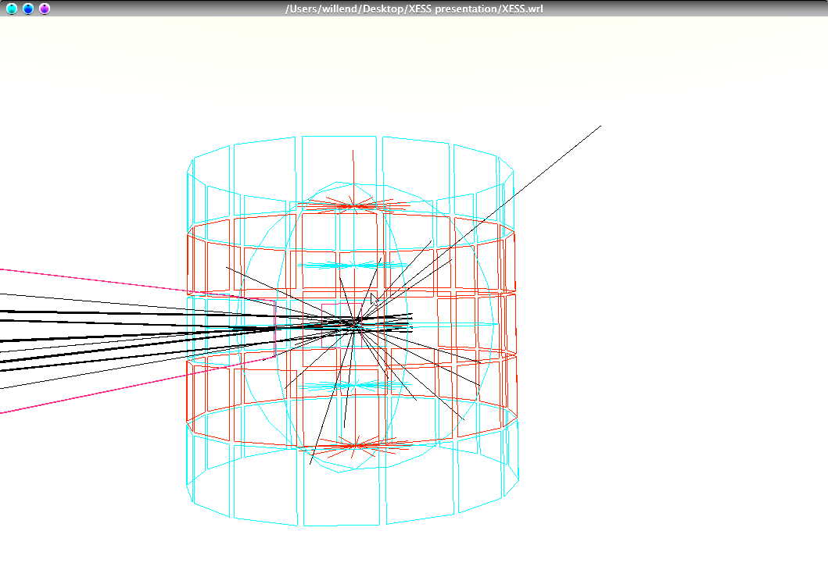
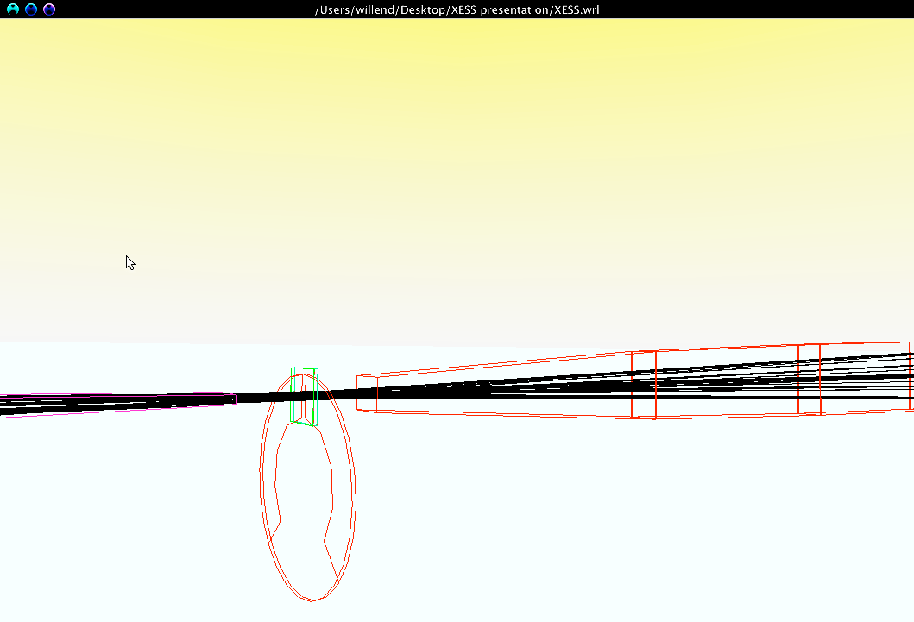
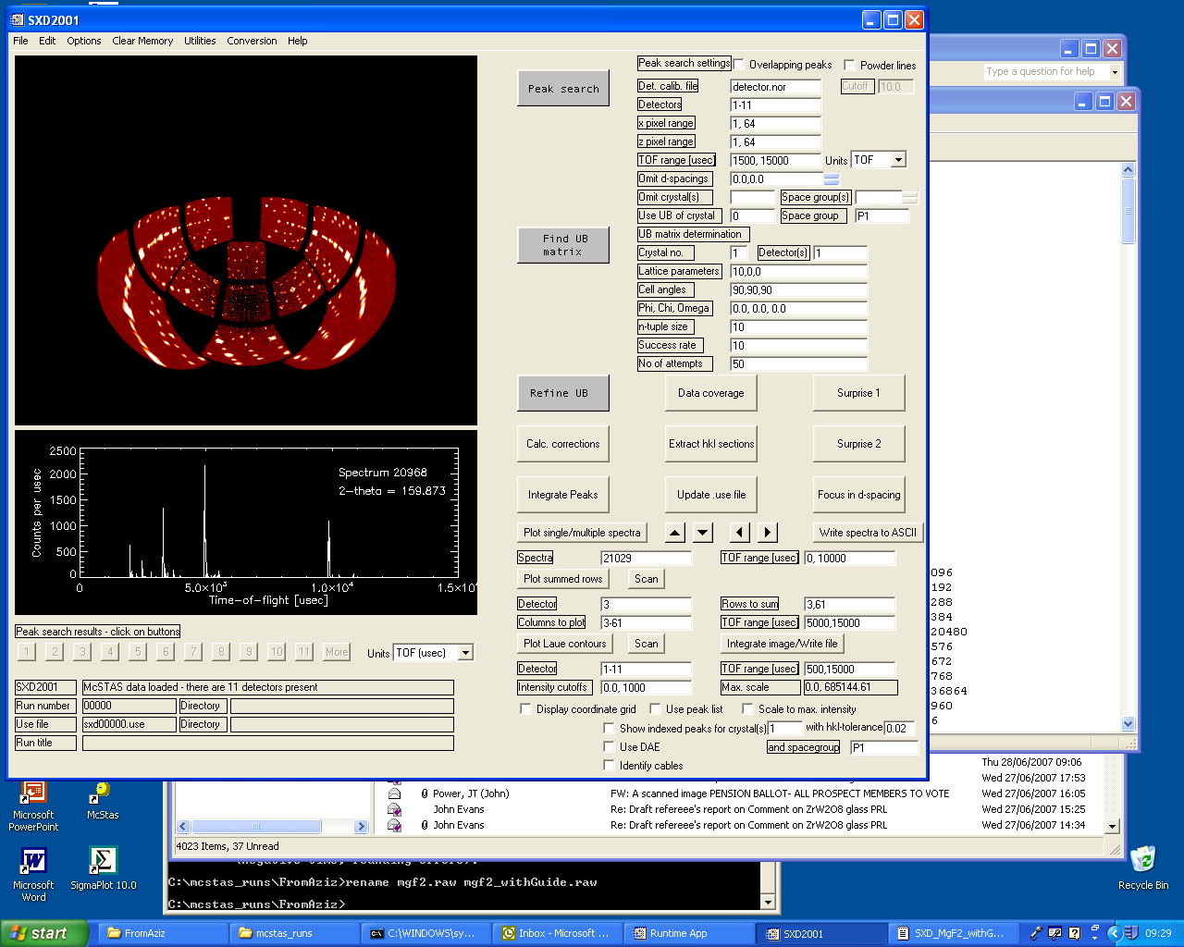
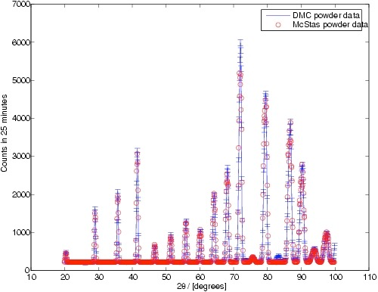
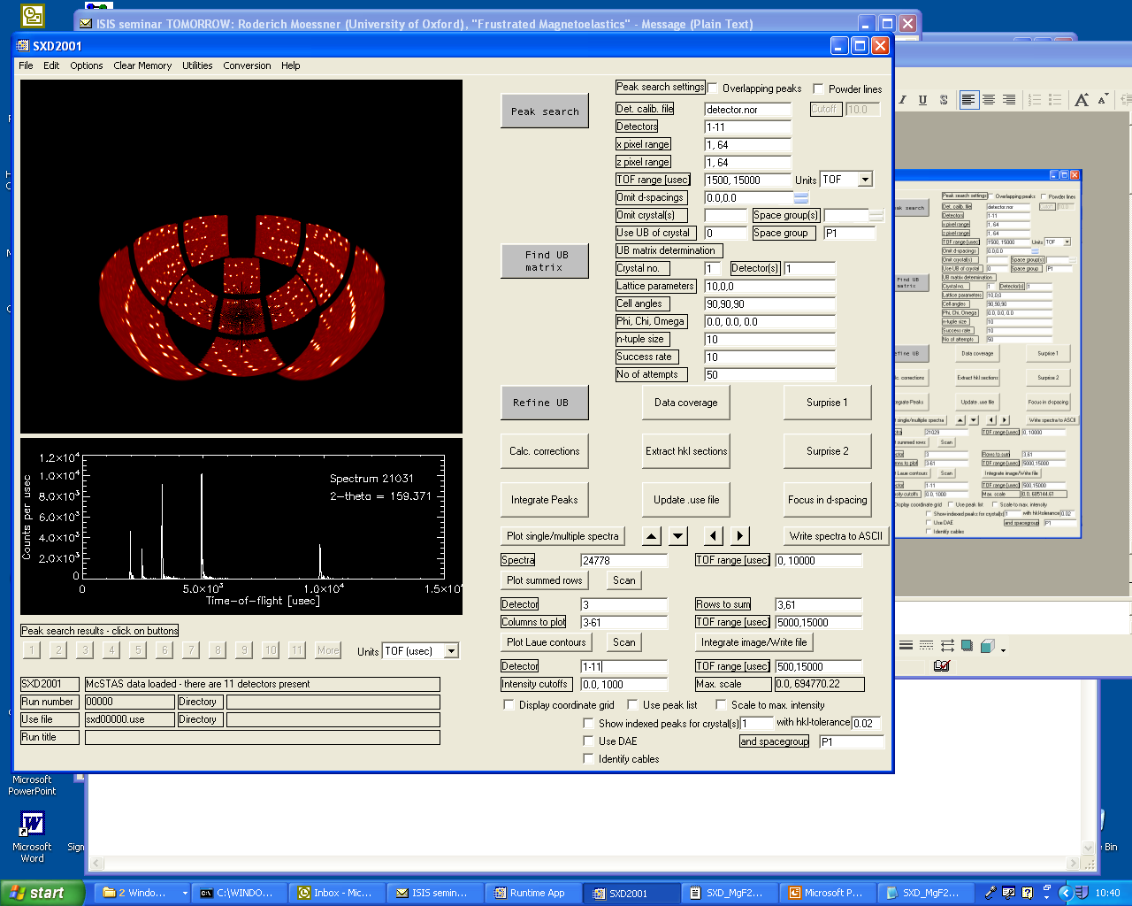
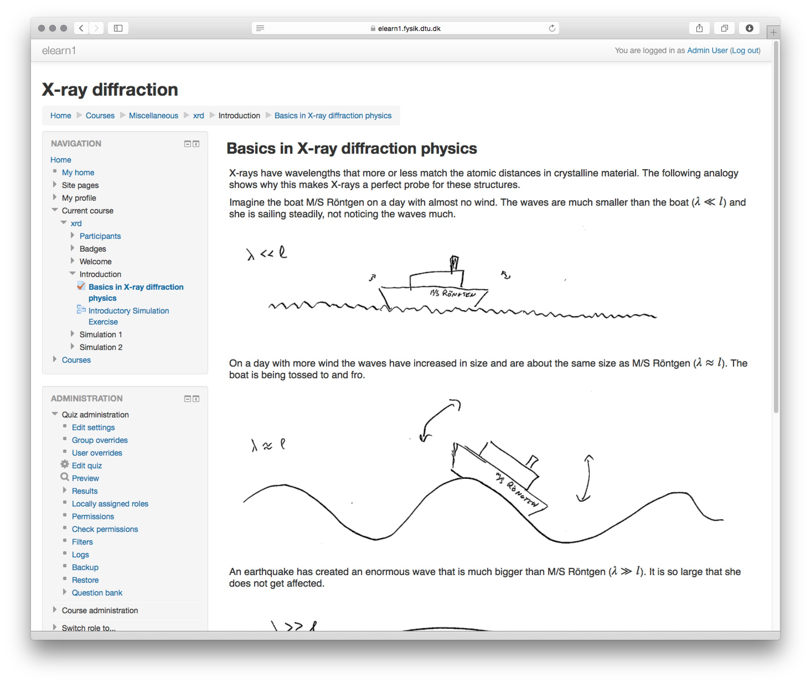
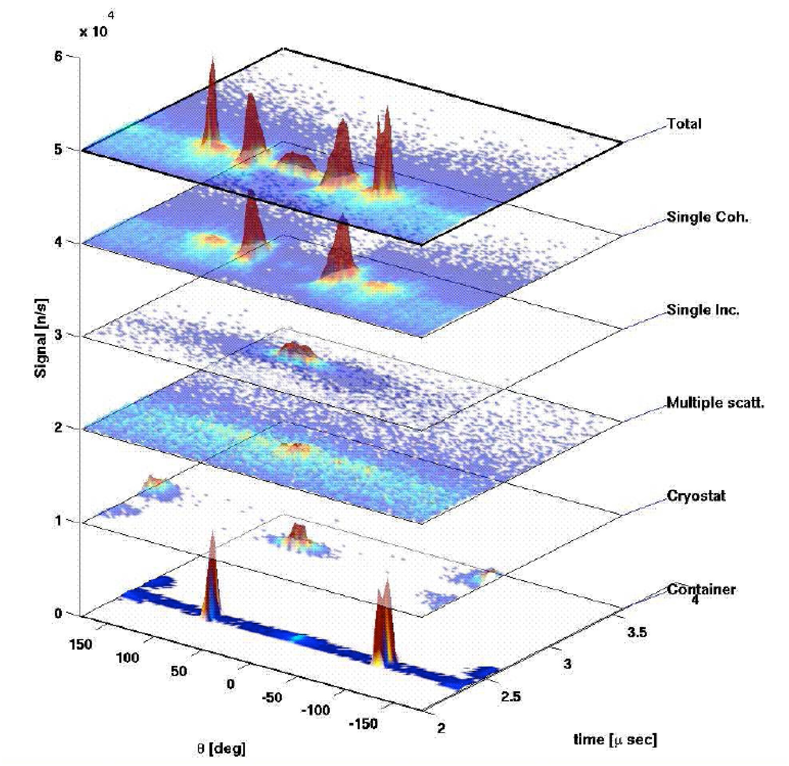
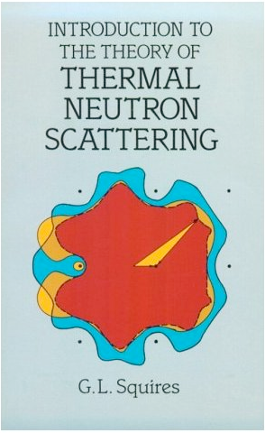
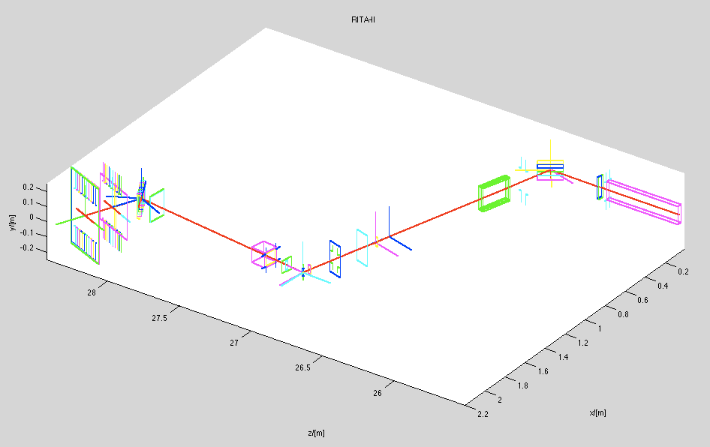
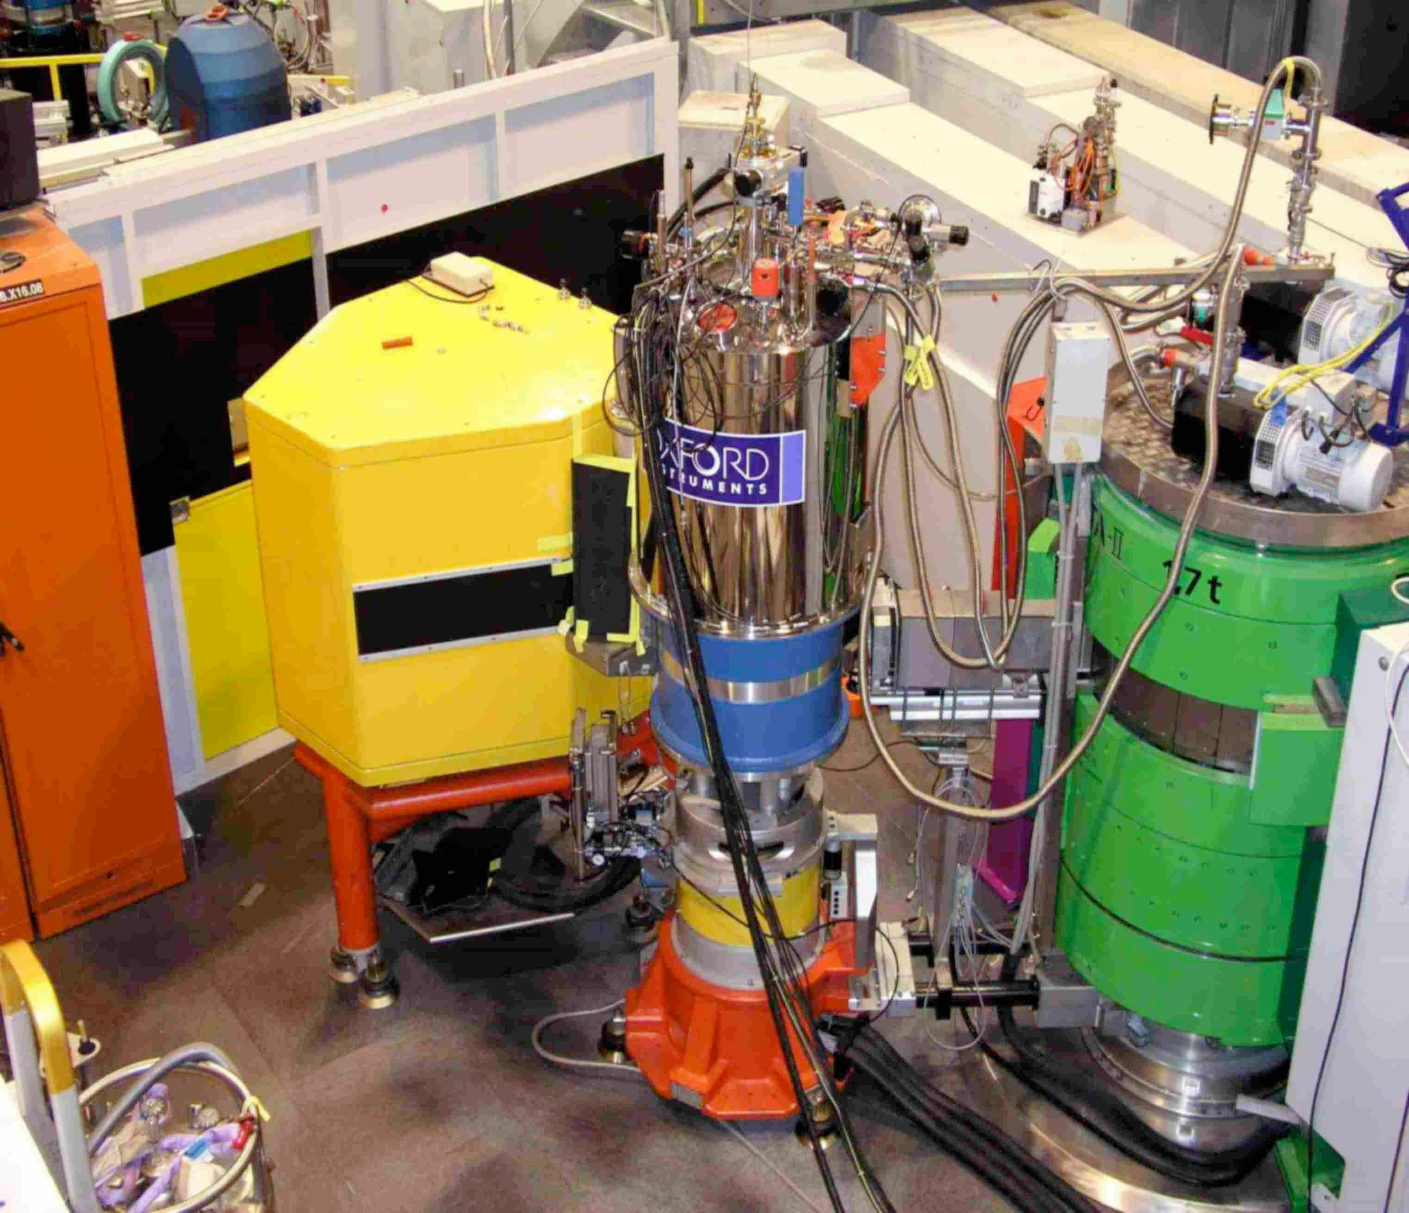
What are the codes used for?
Instrumentation
Virtual experiments
Data analysis
Teaching
(KU, DTU)
McStas and McXtrace: simulation tools for neutron- and X-ray instruments

Slide 18
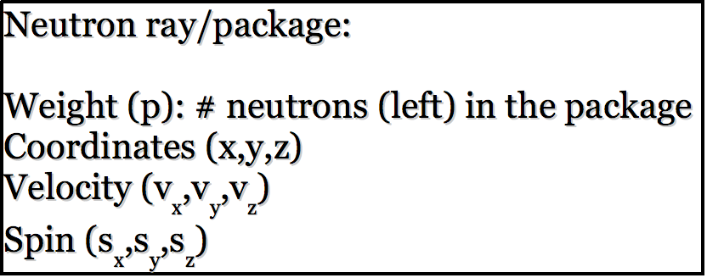
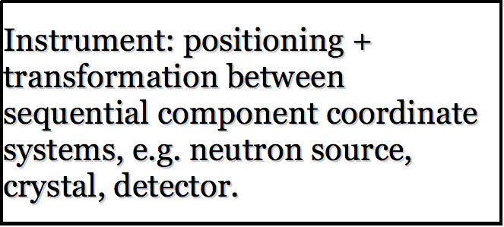
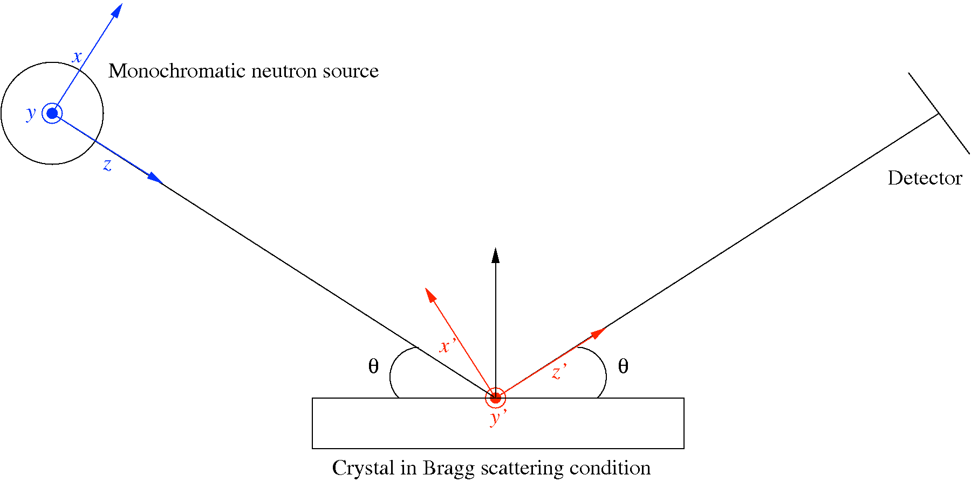
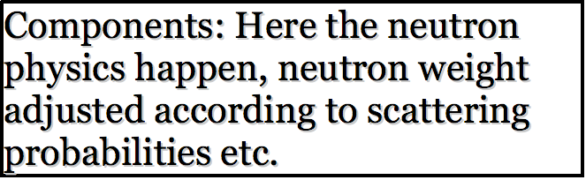
McStas: key concepts
Time (t)
n
n
Local, internal coordinate system!
McStas and McXtrace: simulation tools for neutron- and X-ray instruments

Slide 19

McStas: key concepts
X-ray package:
Weight (p), # photons (left) in the package
Coordinates (x,y,z)
Wavevector (kx,ky,kz)
Polarization (Ex,Ey,Ez)
Phase ( )
Time(t)
Time (t)
X-ray
X
X
Local, internal coordinate system!
McStas and McXtrace: simulation tools for neutron- and X-ray instruments

Slide 20


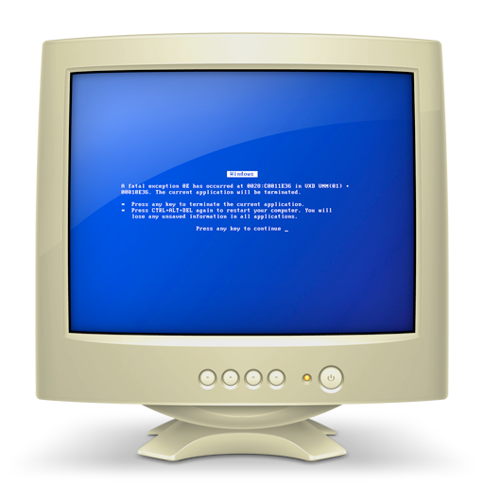
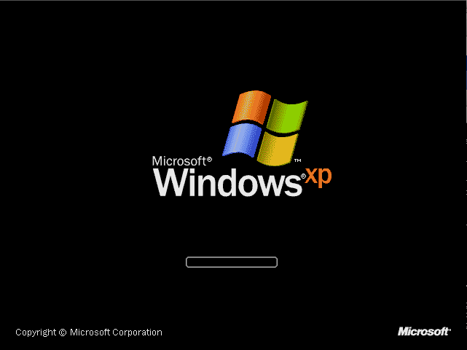

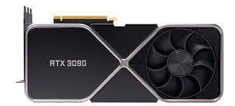
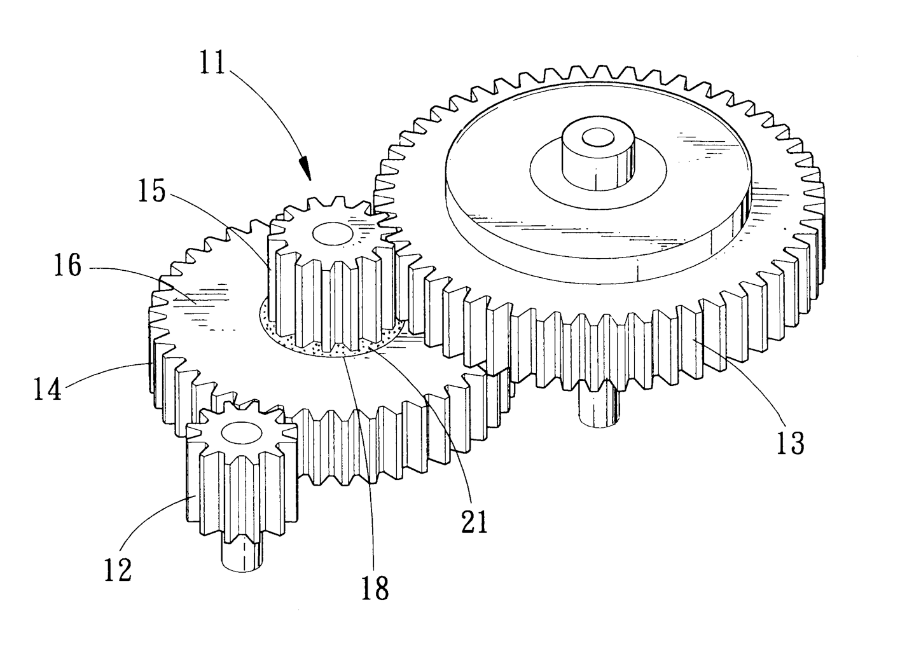
McStas/McXtrace tech overview
Portable code (Unix/Linux/Mac/Windoze)
Ran on everything from iPhone to 1000+ node cluster!
'Component' files (~259/~105) inserted from library
Sources
Optics
Samples
Monitors
If needed, write your own comps
DSL + ISO-C code gen.
+ NVIDIA GPU’s
CPU’s
Instrument file (average
user, point/click, DSL)
Component (advanced user, modify from
existing, c-code)
Kernel
(McCode team)
McStas and McXtrace: simulation tools for neutron- and X-ray instruments

Slide 21
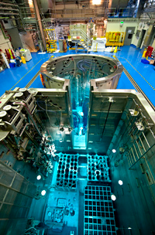
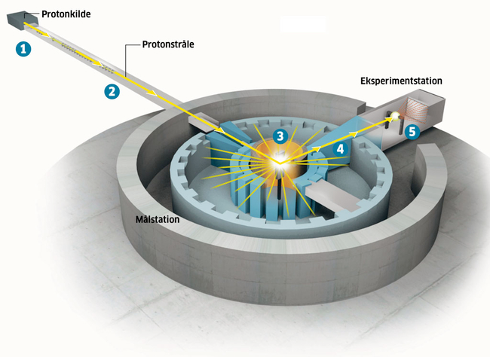
Sources - 1
X-ray sources
Lab equipment
X-ray tube
Rotating anode
Liquid jet anode
Synchrotron
Bending magnet
Wiggler
Undulator
XFEL
SASE (very long undulator)
Neutron sources
Lab equipment
Radioisotope-based
CANS (Compact accellerator based)
Steady state sources
Research reactors
Spallation source at PSI
Pulsed sources
Spallation sources, SP LP
Pulsed reactor (Dubna)
Most neutron sources require moderation of the neutron energy
McStas and McXtrace: simulation tools for neutron- and X-ray instruments

Slide 22
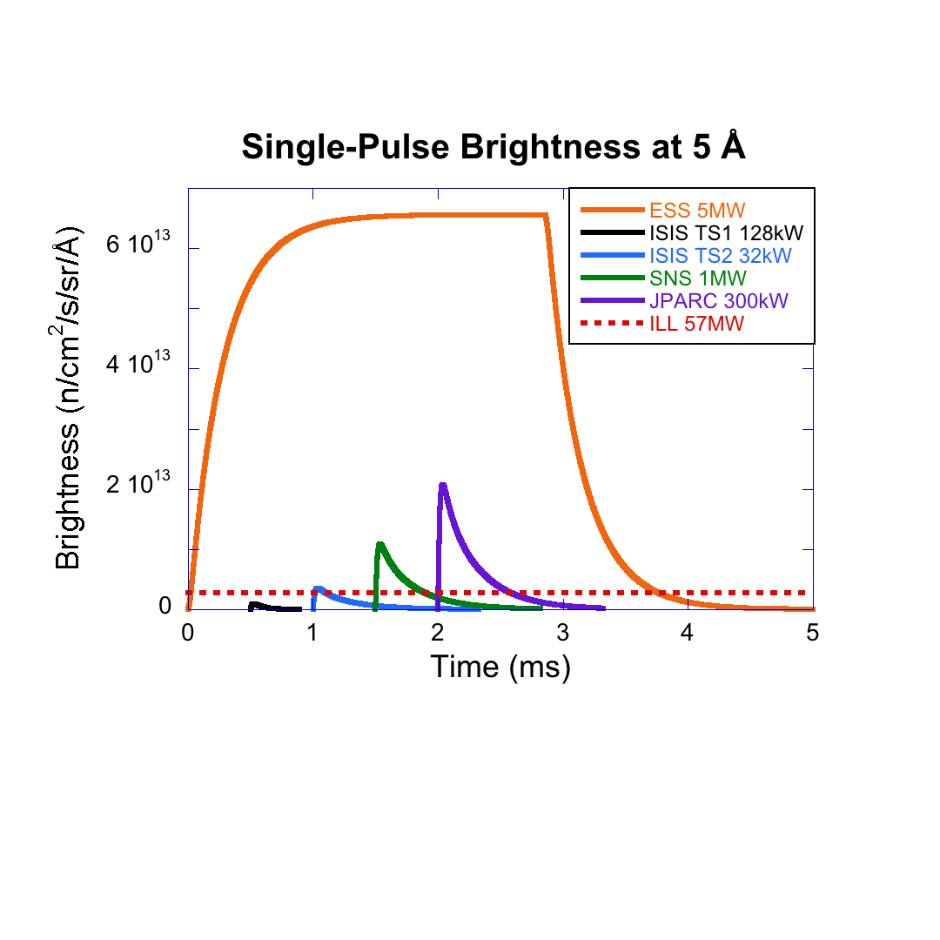

Sources - 2
X-ray sources
Lab equipment
X-ray tube
Rotating anode
Liquid jet anode
Synchrotron
Bending magnet
Wiggler
Undulator
XFEL
SASE (very long undulator)
Neutron sources
McStas and McXtrace: simulation tools for neutron- and X-ray instruments

Slide 23




Spatial / directional beam adjustment
Spatial: pinholes / slits / apertures
Static or adjustable “hole” in absorbing material
Directional: slit-assemblies or collimators
Two or more slits defines an accepted divergence
Collimators makes “channels”, typically with absorbing walls
Usually static devices, but rotating radial collimators exist
McStas and McXtrace: simulation tools for neutron- and X-ray instruments

Slide 24





Temporal beam adjustment, rotating optics
X-ray and neutrons
Choppers
Neutrons only - monochromating rotating optics
Fermi-chopper “rotating collimator” Velocity-selector
McStas and McXtrace: simulation tools for neutron- and X-ray instruments

Slide 25



Crystal-based monochromators - Braggs law
X-ray
Typically very little mosaicity (perfect single crystal Si, Ge, C,…)
Laue and Bragg geometries (transmission vs. reflection)
Creates narrow, low-divergence monochromatic beams
Neutron
Typically high-mosaicity (pyrolytic graphite, deformated Cu, Ge, …)
Often focusing, multi-crystal
Typically Bragg geometry (reflection)
Creates medium divergence monochromatic beams
McStas and McXtrace: simulation tools for neutron- and X-ray instruments

Slide 26




Refractive optics
X-ray
Refractive lenses (CRLs)
Kinoform Lens
Fresnel Zone Plates
Neutron
Refractive Lenses (CRLs)
Magnetic Materials (focusing e.g. “spin-up”)

Slide 27

Refractive optics, total reflection - a reminder
Visible light
n2=1
n1>1
Absorption term
Refraction term

Slide 28



Refractive optics
X-ray
Refractive index < 1
Neutron
Refractive Index < 1 for b>1
With neutrons, Lens effect from magnetism is small, hence “CRL”
Low Z materials with low absorption. Be, Al.
High b materials with low absorption. Mg2F
CRL’s are a reasonable way to have low absorption with
sufficient refraction

Slide 29

Multilayers
X-ray and neutrons
Playing with phase of partial ray reflected from a given layer in the structure

Slide 30
Multilayers
X-rays:
Superstructure often used as “monochromator” - also in focusing geometry
When used as monochromator, use one of the first “side peaks” on the reflectivity curve

Slide 31

Multilayers
Neutrons:
Superstructure “extends” the total-reflection range in Q by “Bragg peaks”
ideally a wide, flat distribution
used in all kinds of neutron optics, but specifically in guides - “optical fibre”

Slide 32








Example suite - instruments: 247 McStas 63 McXtrace
McStas and McXtrace: simulation tools for neutron- and X-ray instruments

Slide 33
Questions?

Slide 34
Now we proceed to the simulations
Form groups of 2 to work together, e.g.
Take turns @ keyboard
Discuss as you go along, interact and compare results
Use https://e-learning.pan-training.eu/course/view.php?id=104 to access McStas and McXtrace (I demo this at first)

